Slide 1

Team Transformer Architects IBM watsonx Challenge 2025
The future of AI is about agency and productivity
Ahmed Sallam, Deniz Askin, Jean Paul Tabja, Jerry Shao, Jonathan Messiha, Mauricio Acosta
August 2025
Notes:
A lightning-fast, few-slide walkthrough that shows how IBM watsonx Orchestrate turns raw business pain-points into production-grade AI agents. Demystifies the platform with a one-sentence mission and three core building blocks (Agent = LLM + Tools + Instructions). Contrasts a frustrating TFSA-banking chatbot today with a sleek, 30-second agentic future that slashes cost-per-session from $25 to $5. Peeks under the hood of the TFSA demo, revealing how a Classification Agent routes queries to specialized Policy, Calculation and Transaction Agents, then stitches their outputs into a single seamless answer. Distills the entire development cycle into a five-command recipe—from `pip install` to live chat—so any developer can launch an intelligent assistant in minutes.

Slide 2
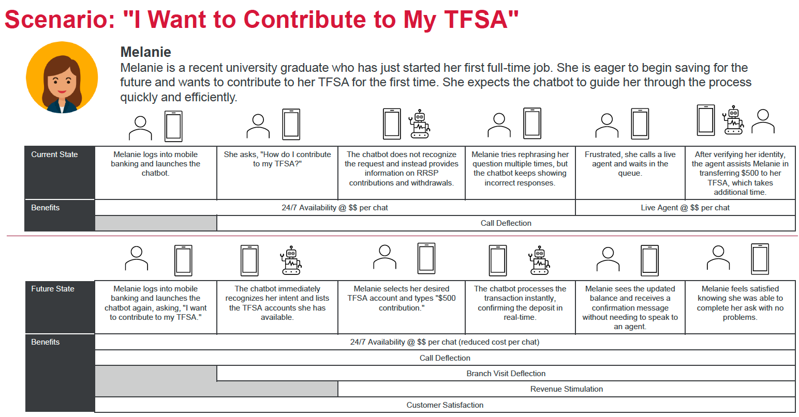
Use Case: TFSA “Smart-Banking” Demo
Three core value propositions:
Real-time Compliance - Validates actions against live CRA regulations using policy agents trained on regulatory documents
Personalized Guidance - Calculates contribution room using individual financial profiles and simulates tax implications
Seamless Execution - Processes transactions with bank-grade security while generating FINTRAC-compliant audit trails
2
Notes:
Mission: Build AI agents that automate complex, multi-step business workflows and integrate securely with any system.
An AI agent is an autonomous system that can use tools and collaborate with other agents to plan and act on tasks. After it acts, the agent reflects on the results of its actions, learning iteratively and refining its approach to better align with its defined objectives.
Key Concepts
Agent = LLM + Tools + Instructions
Styles: Default (fast), ReAct (reason-act), Plan-Act (pre-plan)
Orchestrator Agent coordinates specialists for end-to-end tasks.
The Orchestrator Agent is a multi-agent, multi-tool supervisor, router, and planner, facilitating complex task execution

Slide 3
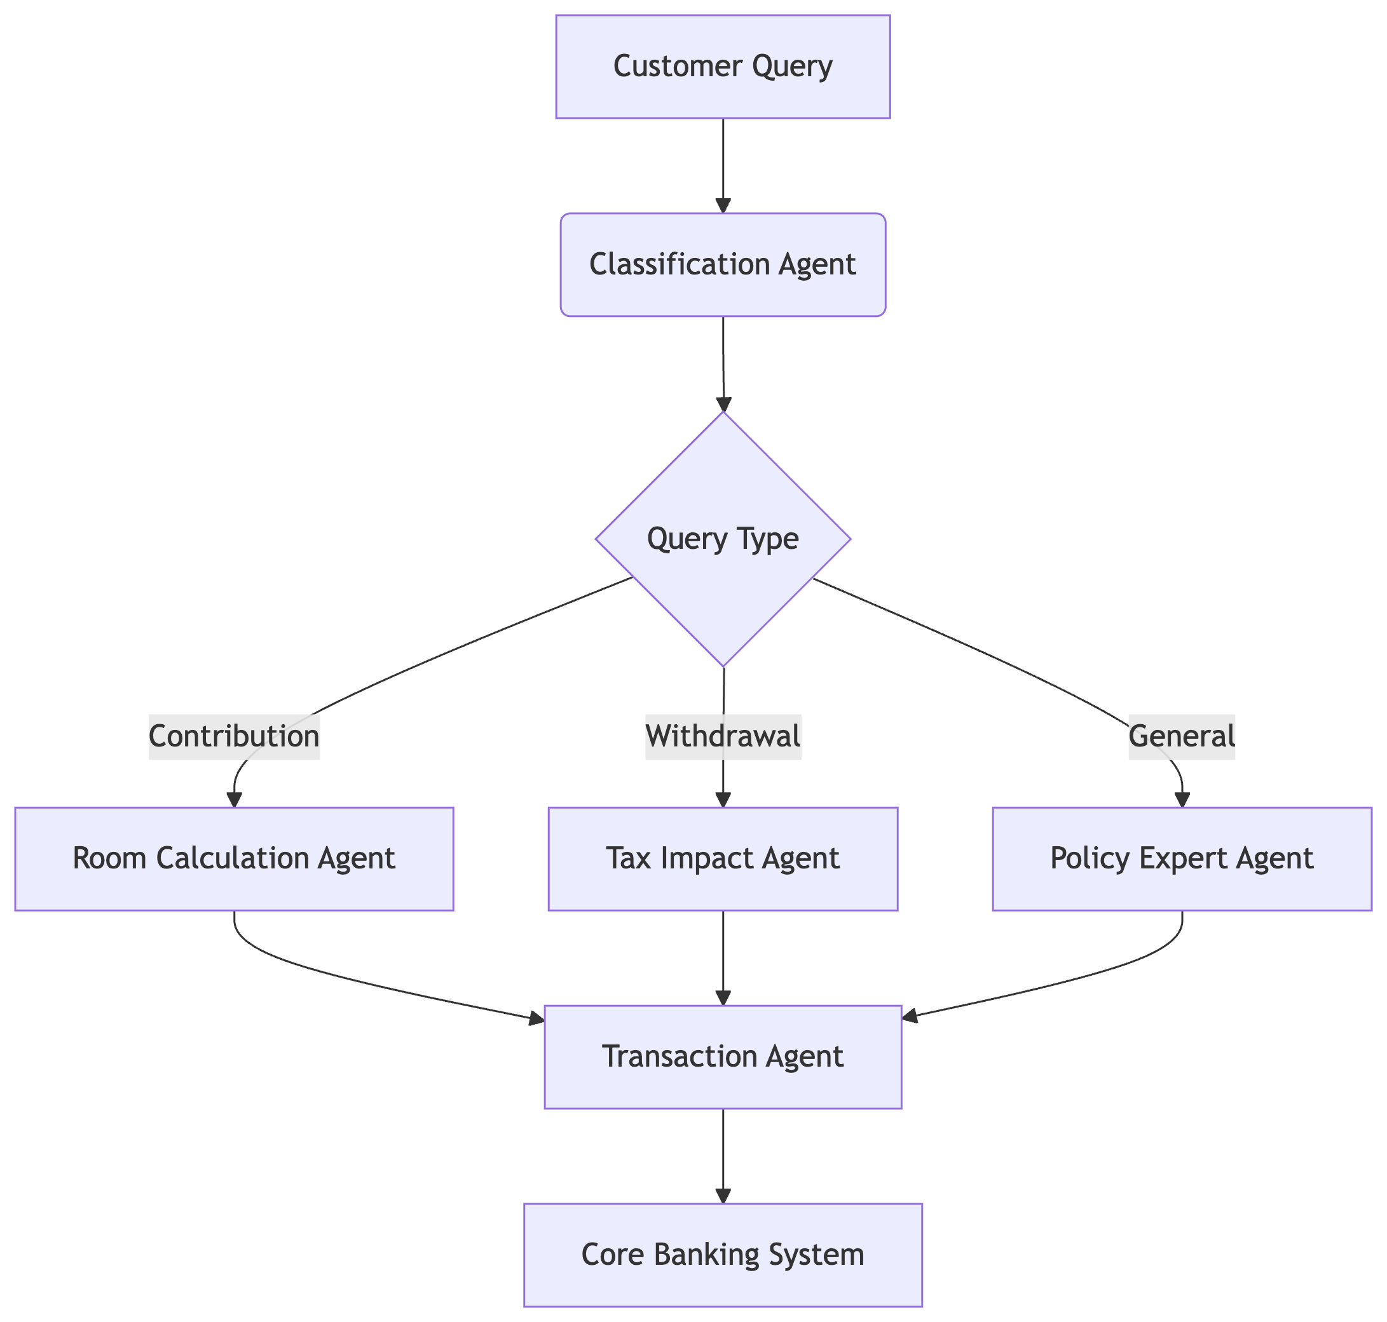
Architecture Behind the Magic
User Query
Classification Agent - Route to specialist:
Policy Agent – live CRA rules
Calculation Agent – personalized room
Transaction Agent – bank-grade execution
Orchestrator stitches answers → user
Tools used:
search_cra_tfsa_police
calculate_contribution_room
execute_tfsa_contribution
3

Slide 4
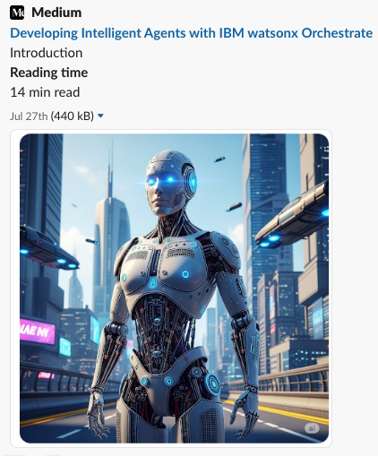
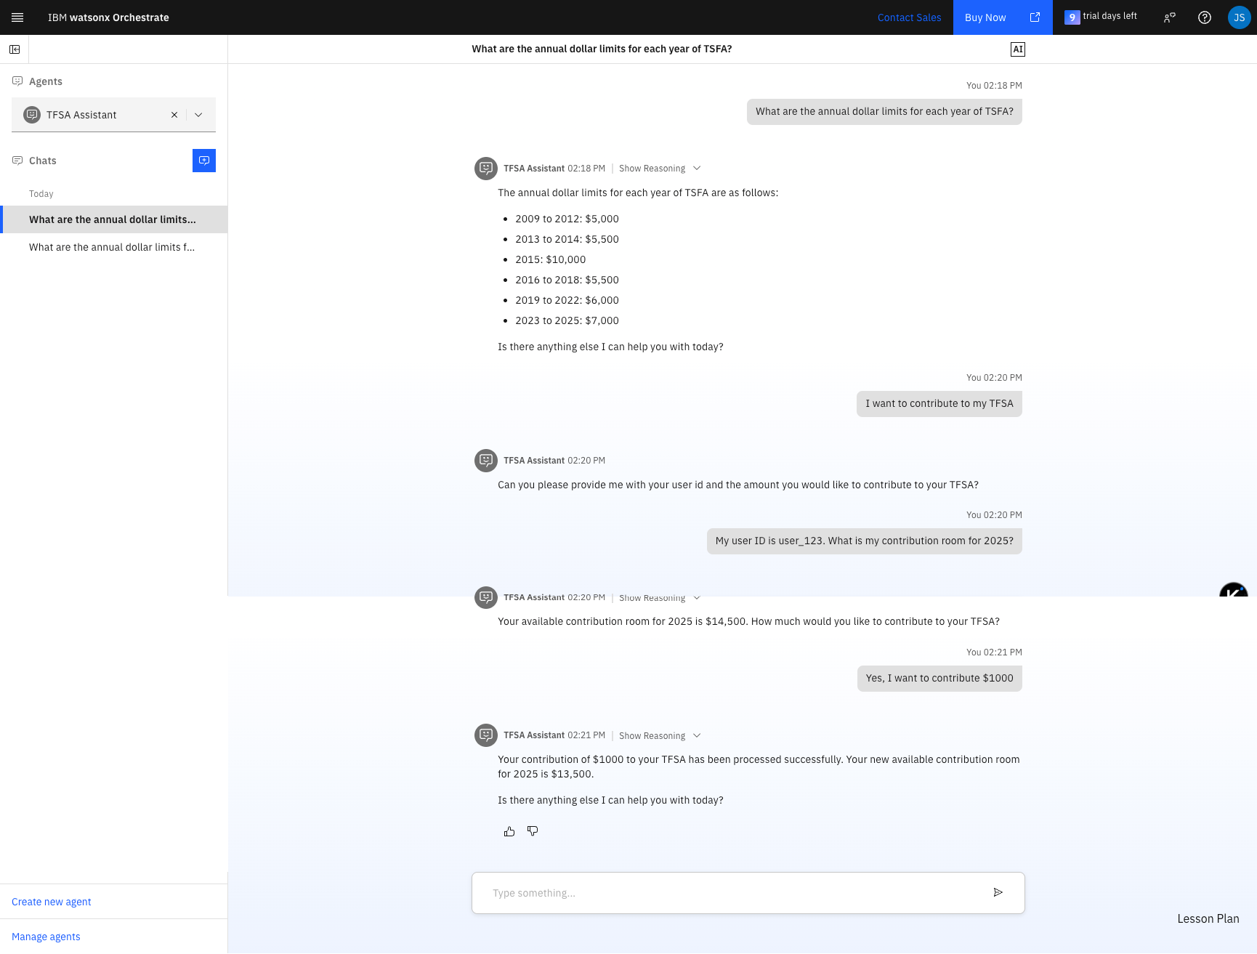
5-Minute Build & Deploy
Deployment Steps
`pip install ibm-watsonx-orchestrate`
`orchestrate env add …` (connect cloud)
`orchestrate connections import tavily_search.yaml`
`orchestrate tools import tools.py`
`orchestrate agents import *.yaml` → chat ready!
Test:
“What are the annual dollar limits for each year of TSFA?”
“What are the overcontribution penalty policies?”
“What are withdrawal rules?”
“I want to contribute to my TFSA”
“My user ID is user_123. What is my contribution room for 2025?”
“Yes, I want to contribute $2000”
4

